Slide 1
Introduction to Unit Testing and TDD
JUnit 5

Slide 2
What is a unit test?
Unit tests are typically automated tests written and run by software developers to ensure that a section of an application (known as the "unit") meets its design and behaves as intended.
(Wikipedia)
In Java, it’s possible to write special classes to test if the code in your program gives the expected results.

Slide 3
What's unit testing?
Characteristics of unit testing:
Fixes bugs early in the development cycle
Helps developers to understand the code base
Enables them to make changes quickly (because it’s modular)
Good unit tests serve as project documentation
Unit tests promote code reuse

Slide 4
Example scenario
If you were to implement a calculator that supports the sum operation.
Your acceptance criteria might be:
if numbers are positive the result should be positive.
if numbers are negative the result should be negative.
if numbers are opposite the result should be zero.

Slide 5
Example of a test written in Java
Acceptance criteria: if numbers are positive the result should be positive.
public class CalculatorTest {
@Test
public void testSum_BothNumbersArePositive_ShouldReturnPositiveNumber() {
// Arrange
int a = 10;
int b = 20;
Calculator calc = new Calculator();
// Act
int result = calc.sum(a, b);
// Assert
Assert.assertTrue(result > 0);
}
}
Take a look at the full example code

Slide 6
Unit testing frameworks
Unit testing frameworks for various languages:
JsUnit for Javascript
Mockit for Angular
PyUnit for Python
CppUnit for C++
PhpUnit for Php
JUnit for Java

Slide 7

JUnit
https://junit.org/junit5/
JUnit is a unit testing framework for the Java programming language. It is an open-source framework, and is used to write and run repeatable automated tests.
Easy to setup and run.
Supports annotations.
Allows certain tests to be ignored or grouped and executed together.
Supports parameterized testing, i.e. running a unit test by specifying different values at run time.
Supports automated test execution by integrating with build tools like Ant, Maven, and Gradle.

Slide 8
Some Vocabulary
Unit: block of code to be tested
Assertion: verification of an expected result. If the check fails, an exception is thrown and the current test stops.
Fixture: initialization / termination common to all unit tests
Suite: a set of executable unit tests

Slide 9
Common Annotations
Annotations are like meta-tags that you can add to your code, and apply them to methods or in a class. Some common annotations:
@Test - Marks the method as a test method.
@BeforeEach and @AfterEach sandwiches each test method in the class.
@BeforeAll and @AfterAll sandwiches all of the test methods in a JUnit test class.

Slide 10
Example of a test written in Java
The class we want to test
public class MyUnit {
public String concatenate(String one, String two){
return one + two;
}
}

Slide 11
Example of a test written in Java
The JUnit unit testing the concatenate() method
import org.junit.jupiter.api.Test;
import static org.junit.jupiter.api.Assertions.*;
public class MyUnitTest {
@Test
public void testConcatenate() {
MyUnit myUnit = new MyUnit();
String result = myUnit.concatenate("one", "two");
assertEquals("onetwo", result);
}
}

Slide 12
Example of a test written in Java
The JUnit unit testing the concatenate() method
Import annotation
@Test
import org.junit.jupiter.api.Test;
import static org.junit.jupiter.api.Assertions.*;
public class MyUnitTest {
@Test
public void testConcatenate() {
MyUnit myUnit = new MyUnit();
String result = myUnit.concatenate("one", "two");
assertEquals("onetwo", result);
}
}
Class naming convention - suffix ("Test")
Annotation "@Test" indicating that the method is a test to be executed

Slide 13
Example of a test written in Java
The JUnit unit testing the concatenate() method
import org.junit.jupiter.api.Test;
import static org.junit.jupiter.api.Assertions.*;
public class MyUnitTest {
@Test
public void testConcatenate() {
MyUnit myUnit = new MyUnit();
String result = myUnit.concatenate("one", "two");
assertEquals("onetwo", result);
}
}
Execution of the method to be tested
Creating an instance of the class to be tested
Assertion verifies the execution results of the code to be tested

Slide 14
Assert methods
Junit provides a class named Assert, which provides a set of assertion methods useful in writing test cases and to detect test failure.
The methods are as follows: (click each one to learn more)
assertArrayEquals()
assertEquals()
assertTrue() + assertFalse()
assertNull() + assertNotNull()
assertSame() and assertNotSame()
assertThat()

Slide 15
Test Driven Development (TDD)

Slide 16
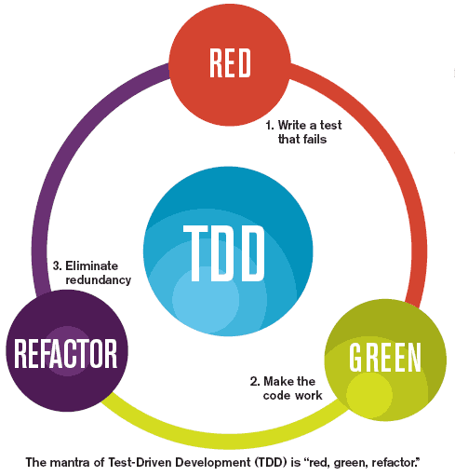
Add a test Before writing the application code
Forces you to think about your code before writing it!
Check that the test does not pass
Normal since the code is not written
Implement the functionality
At the very least, just so it can send back a proper test...
Perform unit tests
Check that the tests pass, otherwise debug
Refactor the source code and re-run unit tests
If still ok, move on to the next objective and start the process again at step 1.

Slide 17
Benefits of TDD
Forces you to write tests in a systematic way: more tests = less bugs and regressions
Forces to think ahead about the implementation before coding (class names, methods, parameters, return values, behaviors...)
Encourages you think of all the possible scenarios that could lead to malfunctions.
Allows a better code breakdown by limiting the complexity of each step (step by step realisation)
In the end, it's the code that adapts to the tests, writing tests beforehand means writing code that is easily testable! Otherwise, there is a risk of testing portions of badly written code which is therefore difficult to write and test.

Slide 18
Workshop

Slide 19
Workshop
Write a basic test using JUnit:
Follow this Getting Started guide to create your first unit test
Have fun!

